Slide 1
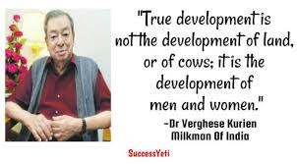
TRIBUTE TO THE HERO OF THE DAY AND GUIDING SOURCE TO INDIANS - DR VERGHESE KURIEN

Slide 2
Welcome and Greetings to the Management, Professors and Students of Karpagam Community
Only one Message to Students –
Enjoy as student and every part of the life but be True & Responsive to yourself.

Slide 3
Life ambition
5 samples – What is mine
What is Your’s ?
You don’t have to be great to Start but you need to Start – The theme Start up Enclave
All we discuss, every bit here for 2 Hrs including Politics shall for a Business, Business, Business.
TALK ABOUT ME, OTHERS,CONCEPT FOR BUSINESS.

Slide 4
A PROPOSAL
FOR OPEN MIND
A JOINT AGRI BUSINESS VENTURE BETWEEN KARPAGAM AND CUMULO NIMBUS AGRO.
ALLIVIATING THE PRESENT CRISIS OF INDIAN FARMERS THROUGH KURIEN’S AGRI BUSINESS MODEL AT MICRO LEVEL TAMILNADU – AN OPPURTUNITY TO YOUNG GRADUATES

Slide 5
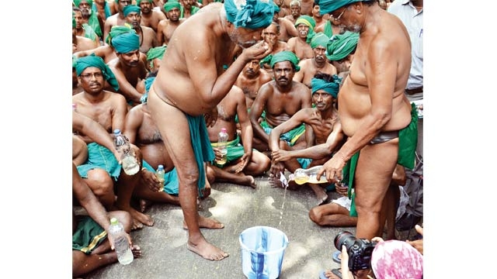
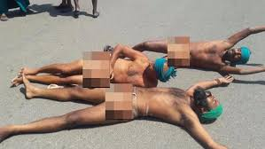
AMMANAM & ASINGAM

Slide 6
Other titles Created
REMOVE THE AMMANAM(NAKED) ASINGAM(BAD) & AVAMANAM(SHAME) OF INDIAN FARMERS BY KURIEN’S AGRI BUSINESS MODEL
AMMANAM – NAKED .
ASINGAM - TN farmers resort to drastic measures, drink own urine

Slide 7
ALL SUCCESSFUL PEOPLE IN THE LIFE MET THE ASINGAM AND ALSO AVAMANAM.
SO LET US BIGIN TO RAISE THE PRODUCERS WHO MET THE BOTH As

Slide 8
Game Plan
About CBM
Understanding the Crisis
What is Dr.Kurien’s Agri Business Model
Solving the Crisis by the Agri Business Model
Can you be a Kurien/ CEO in somewhere and in some place for the farmers with your plan.
Can we make a start & plan within another 15 days.

Slide 9
Introduce my Major Gods
Parents – Chenniappan and Ramayammal
My Uncle Duraisamy
Swamy Chidbhavananda
Dr.Kurien
Irfan Allana – Chairman Allana
Sundarrajan – MD., Suguna Foods
Kalamani – My bitter Half
VIRTUES DO NOT MAKE MANAGERS

Slide 10
I BELIVE IN
MAKE COMPETITVE ADVANTAGE +VELY, SHOW THE DIFFERENCE TO OTHERS.

Slide 11
What is the Problem ?
Problem an Opportunity.
Farmers were led and Used
WHAT IS GOVERNMENT ?
FARMERS/ PRODUCERS VS CONSUMERS VS GOVENMENT( task)
Technology / Government.
Loan waiver/ Interest Reduction
Political based

Slide 12
GOVERNMENT
TECHNOLOGY
BOTH ARE MAINLY GOVERNED BY THE GOVERNMENT. BOTH OPERATE ON SOP
YOU GIVE WHAT YOU KNOW, WHAT YOU HAVE. – SOP FORM OF GOVERNANCE
MANAGERS SHALL GIVE WHAT IS REQUIRED
DR KURIEN GAVE WHAT WAS REQUIRED

Slide 13
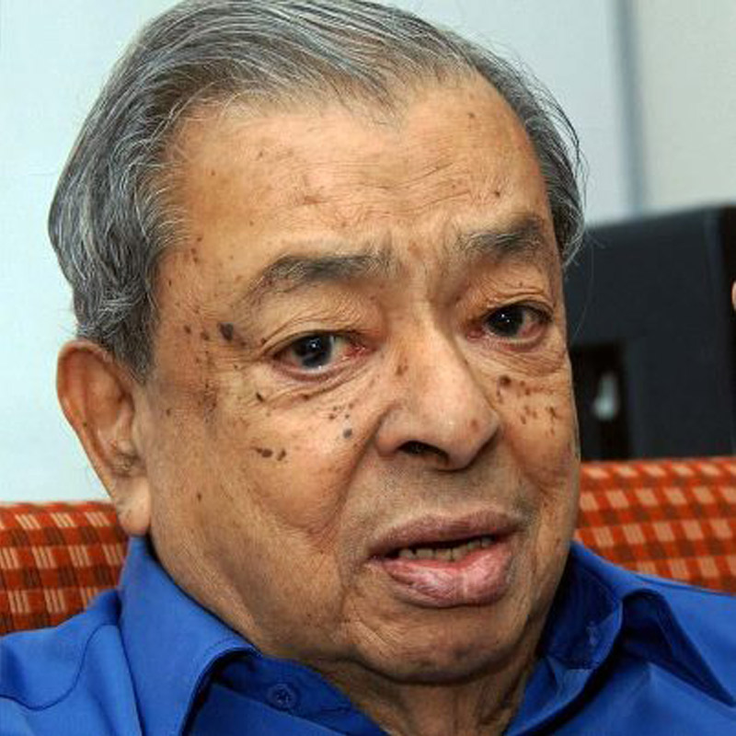
DR.KURIEN, Milk Man of the Country,Father of White Revolution

Slide 14
What Amul & Kurien Made Success
Giving maximum around 70% of Consumer rupee of Milk to the Producers,round the year through Producers institutions.
The biggest and Successful Rural development programme in the World.
Creation of the best Institutions in the World.
Farmers uncommon wisdom- Give them, shall Manage.
Generation Fund and Managing the Material and Fund
“Sir, Please Tell 3 best attributes U to become Success”

Slide 15
Integrity
Integrity
Integrity

Slide 16
Managing the Prime Ministers
Sastri
Mrs.Gandhi
VP Singh,HD Gowda,Gujral,Chandrasekar
PV Narasimha Rao
Rajiv Gandhi
AB Vajpai
Manmohan Singh

Slide 17
Milk – Dairy – Dr.V Kurien
Celebrate the Success
Operation Flood
Most successful Rural Development Programme in the World.
ROI
India – world number one in Milk Production
Round the year Production and Marketing with Volume

Slide 18
Where is Bharath Ratna ?
“A CIVILISED SOCIETY MUST SHOW GRATITUDE, WHEN PEOPLE CAN SENSE IT OR IF NO GRATITUDE AT ALL AND IF OUR COUNTRY DOES NOT STAND AND SALUTE DR VERGHESE KURIEN WITH BHARTH RATNA, I DO NOT KNOW WHO ELSE DESERVE IT”
N R N M

Slide 19
Where is Bharath Ratna ?
Let Us have a Milk Day here and Have Dr.Kurien Memorial Business talk with Students . A PROPOSAL TO CELEBRATE THE SUCCESS.
IT IS VIVEKANANDA , MK & VK MADE COUNTRY PROUD.
COMMON FACTOR BETWEEN THE 3

Slide 20
Tribute Dr.Kurien

Slide 21
Single most Best Commodity in Farmers Revenue
Rs.1.3 L Crs Indian GDP, Agriculture – 17% Dairy 3.5 %
26 Federation 181 District Unions,1.71 Crs DCS 4.25 Cr KGPD
Private participation in Milk
No farmers Suicides in Milk Procurement centres
Number of Employees

Slide 22
Current milk scenario
Domestic milk production
4600 lakh kg/ day*
Milk consumed/ used in production areas itself
2200 lakh kg/day ~ 48%
Surplus milk sold from production areas
2400 lakh kg/day ~ 52%
Surplus handled by:
Unorganised Sector | Organised Sector (Coop + Private⁺)
1600 lakh kg/ day | (400 +400) lakh kg/ day
~ 67% of surplus | ~ 33% of surplus

Slide 23
Success of Amul
2017 -18 Amul shall cross Hindusthan Leaver’s Turn Over by Surpassing Rs 30 K Crs
Did we celebrate the Success of Amul/NDDB and Dr Kurien.?
Where is TUCAS ?
Where is Aavin / Nandhini/ AMUL
Where is the Sugar Cooperatives
Where is Chintamani VS Kannan Departmental stores.?

Slide 24
What is the Great achievement Dr.Kurien made.
70 % of Consumer Rupee went to farmers through Institution of Farmers.
What about other Commodities ?
In US, it is around 40 %
Best Institution – pays maximum to Raw material with a profit.
Green Vs White Revolution – Technology with Consumer oriented vs Farmer centric focussed with Institution.

Slide 25
Shall We find a solution ?
Now, we go in opposite Direction.
Where do we dispose these animals ?
How do you give Protein Supplement ?
Please read Samas Article of Tamil Hindu
BUSINESS IS ONE LAK CRS, NOT KILLING A PARTICULAR COMMUNITY BUT MILK PRODUCERS.

Slide 26
Shall we find solution ?
With Win Win Approach ?
Govt – Technology – Institution
Have to have debate – Defame to Govenment due to Corruption or TASMAC.
Institutions – Govt
Company
Trust
Cooperatives
NGO

Slide 27
The least preferred Institution
Cooperatives.
Govt think it is one of their Arms of Machinary.
What is the solutions ?
It must be accountable with least interference from Govt.
Birth of Producers companies – Made by NDDB/Dr.Kurien

Slide 28
Create an Another Post
“Agri PC to Eradicate the Ammanam, Avamanam & Asingam of Tamilnadu Farmers - A second Farmer Centric Green Revolution & Employment Initiative by Tamilnadu Farmers.”

Slide 29
PRODUCERS’ COMPANY (PC)
Principles of Cooperatives but Independence of the Company/ Company Model.
Producers Company with Producers Institution. (PI)
PI to PC
PC at Taluk , District , State and National level
PCs for Crops at Taluk, District , State and National level

Slide 30
What & Why is Producer Company
A producer company is a hybrid between a private limited company and a cooperative society.
It combines the goodness of a cooperative enterprise and the vibrancy and efficiency of a company.
It accommodates the unique elements of cooperative business with a regulatory framework similar to that of a private limited company

Slide 31
PC can undertake
Procurement
Processing
Marketing for Agri products.

Slide 32
Concept of Producer Company - Introduced
Introduced in 2002 by incorporating a new Part IXA (section 581A to 581ZT) into the Companies Act,1956
Based on recommendations given by expert committee led by economist, Y. K. Alagh

Slide 33
Road Map to PC
Scan the Environment and Feasibility.
Equity and Members through Affinity Groups
Registration of PC
Brand
Procurement . Process & Market to link the consumers
PC Management and Board
Statutory Requirements

Slide 34
PC
PC at National Level
PCs at State level
PCs @ DISTRICT LEVELS
PIs and PCs at Taluk level
1 2 3 4 5 6 7 8 9 10 11 12 – PI @ VILLAGES

Slide 35
Thats OK, My Dear Murugan, How do We or I get benefitted ?

Slide 36
Action Plan
Reach to the visitors of the Agri Tech Event – 2 lakh visitors in 14th to17th July, 2017. CODDISIA,Coimbatore.
With or without a Hall
Need Volunteers to sell the concept to the Visitors
YOU FIX THE TARGET EITHER INDUVIDUAL STUDENT OR BY KARPAGAM MANAGEMENT.

Slide 37
What is the Take
Opportunity is plenty,
Be a CEO – Kurien – Create Institution
PLAN TO GET CEOs – LET US FIX THE TARGET.
Remember- You are an Employee of Farmer, guide the farmers, Through PC.
Cumulo Nimbus shall travel along with Individuals and Management of Karpagam to Eliminate this 3 As

Slide 38
One PC to Remove 3 As
MONEY & Profit all the Stake Holders
CUMULO NIMBUS IS ALWAYS BEHIND U

Slide 39
Manthan – Film by Amul & Shyam Benegal

